Slide 1
Group B Progress Report 8

Slide 2
Content
Continue with HuBMAP+HPA Competition
Quick Review
Future Plan
Q & A

Slide 3
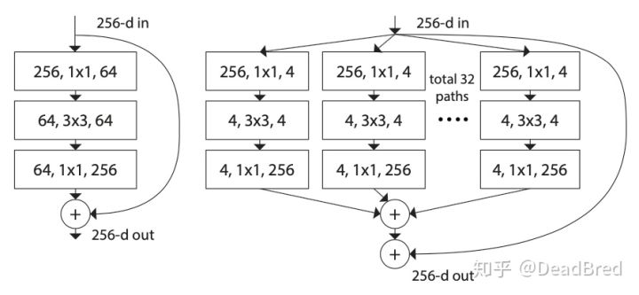
Quick Review for UneXt
Block Difference between ResNet and ResNeXt:
Adding the number of “cardinality” : the size of the set of transformations.

Slide 4
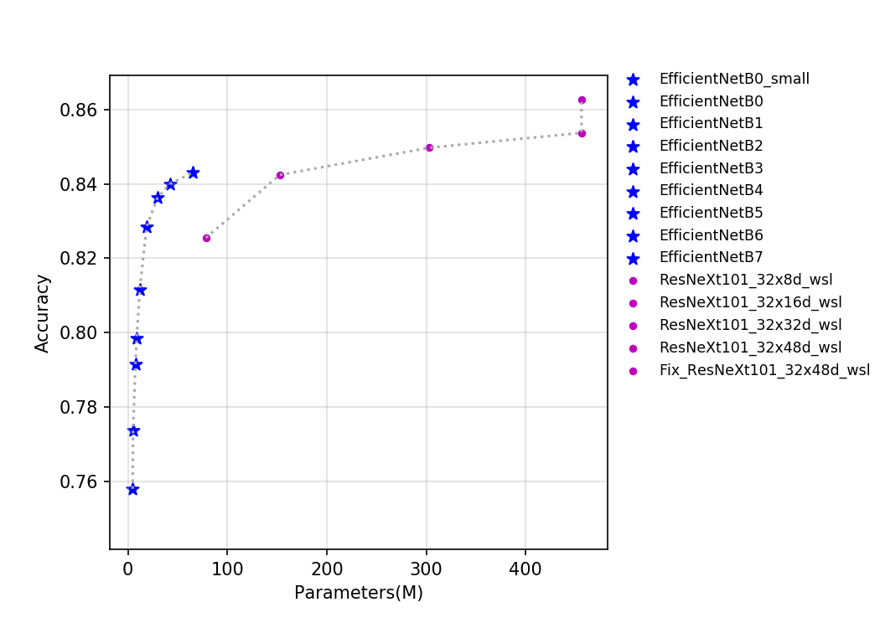
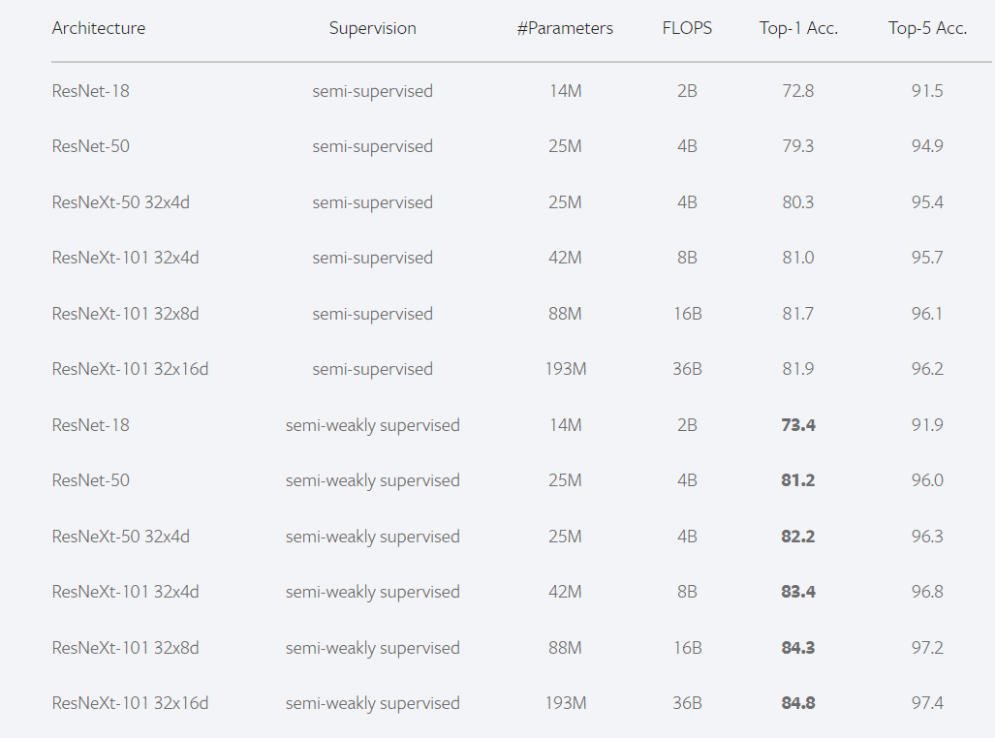
UneXt101
https://paddleclas.readthedocs.io/zh_CN/latest/models/EfficientNet_and_ResNeXt101_wsl.html
https://pytorch.org/hub/facebookresearch_semi-supervised-ImageNet1K-models_resnext/
According to the info. provided by paddlepaddle and PyTorch website, the accuracy in ImageNet-1k of EfficientNet and ResNeXt, we wondered if wider ResNeXt can provide better performance in this competition.

Slide 5
Pre-trained Model of ResNeXt101
For the encoder of the backbone net, we used the pre-trained model (semi-supervised learning & semi-weakly supervised learning in ImageNet-1K) provided by facebookAI & PyTorch
Limited by the short time, we just tried, trained in 30 epoch:
ResNeXt101_4D_ssl
ResNeXt101_4D_swsl
ResNeXt101_8D_ssl
ResNeXt101_8D_swsl
https://pytorch.org/hub/facebookresearch_semi-supervised-ImageNet1K-models_resnext/

Slide 6
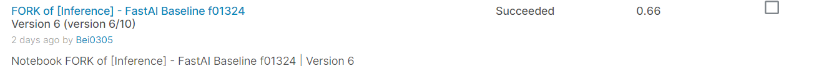

Results
Without expansion and ensemble, the public scores are shown:

Slide 7
Worse performance
The performance of UneXt101_4D model can really improve the score compared with UneXt50_4D, but UneXt101_8D model has worse performance. It is good at dice value, so we think the model is overfitting. (Maybe the noise is the reason)

Slide 8
Quick Review
The improvement points in final result:
1. The data augmentation method
2. The backbone EfficientNet B7
3. The expansion trick
4. Ensemble for UneXt or EfficientNet (maybe)

Slide 9
Future Plans
1. Try a stronger model, like SwinUnet
2. Continue with the data process

Slide 10
Discussion

